Slide 1

FISH TANK CONTROL SYSTEM
GROUP 4
Third Year project
E/16/377 : VINDULA I B S
E/16/332 : SAMARAWEERA A A R V
E/16/127 : HARSHANA P Y S

Slide 2
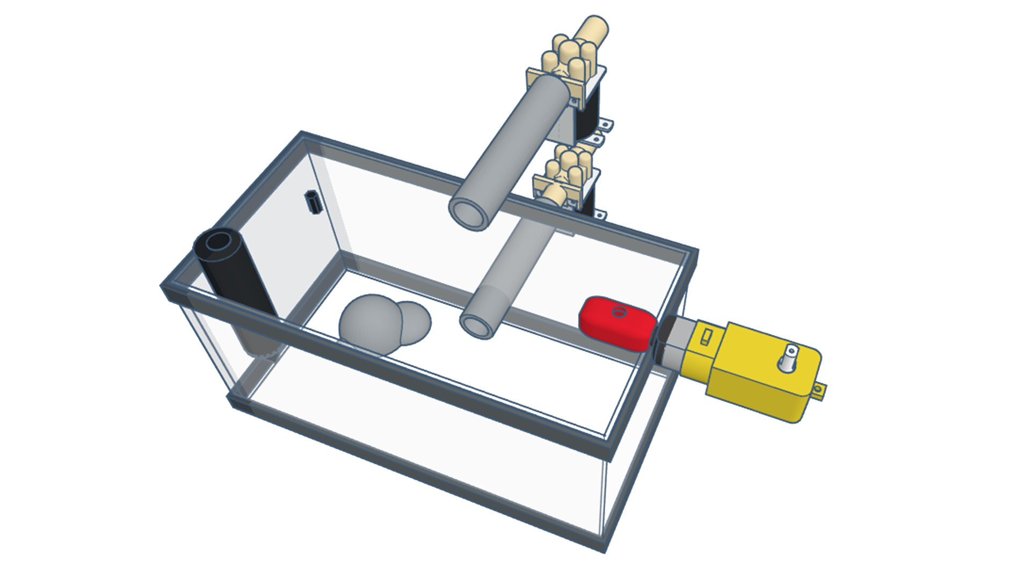
About our project
Read PH value and temperature
Renewing the water
Synchronize Fish Feeding System
Fish Directory

Slide 3




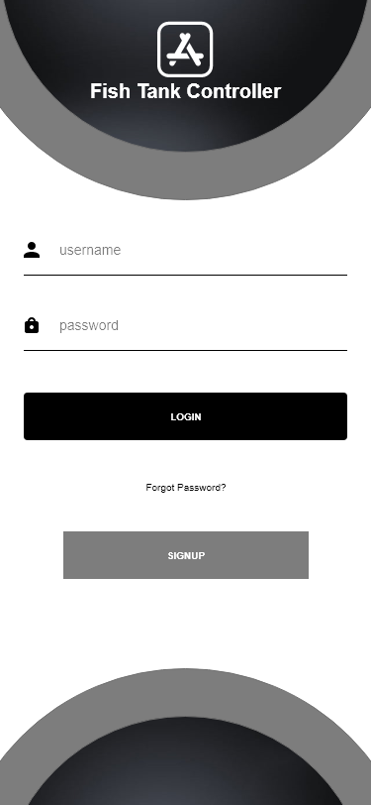
MongoDB
InfluxDB
Data
Structure
Control
Server
Authentication
Server
Control
Server
Authorization
JWT Token
JWT Token
Mobile
App
HTTP
Request
Response
Device
Login
Signup

Slide 4
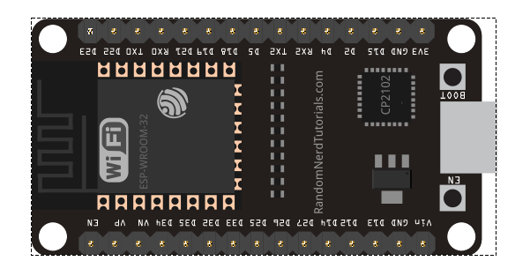
HARDWARE COMPONENTS
ESP-32-WROOM 30 pin
GPIO pins + WIFI module inbuilt
18 Analog-to-Digital Converter (ADC) channels
16 PWM output channels
Dual-core 32-bit LX6 microprocessor, up to 240 MHz
448 KB ROM for booting and core functions
520 KB SRAM for data and instructions
4MB Flash
Supply Voltage : 3.3V

Slide 5
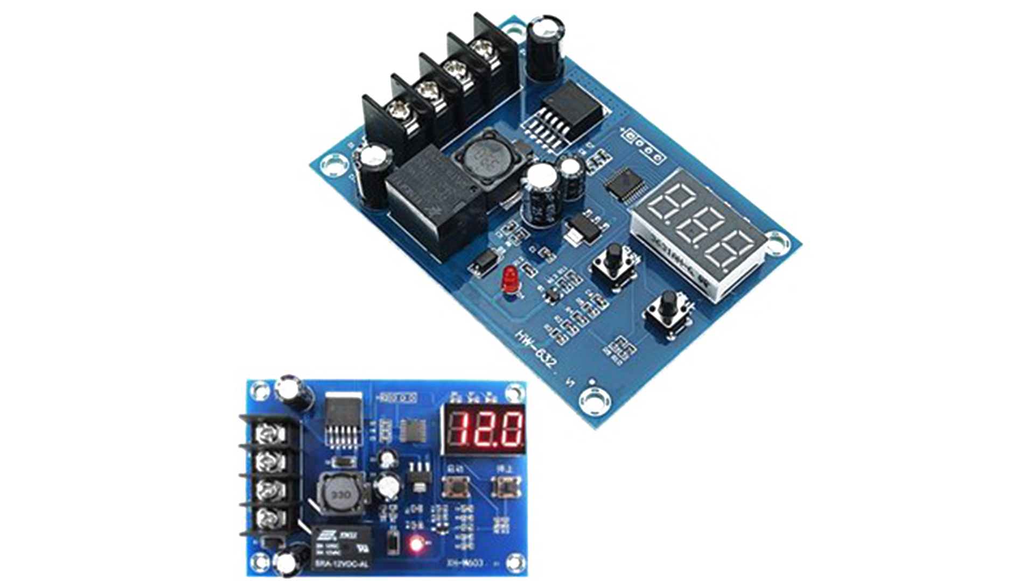

HARDWARE COMPONENTS
XH-M603 Charger module
Input Voltage : DC 10-30V
Can Control Input Voltage
Inbuilt Display
12V 7ah sealed lead acid battery
Very Durable
Rugged Construction
7.2AH Capacity

Slide 6
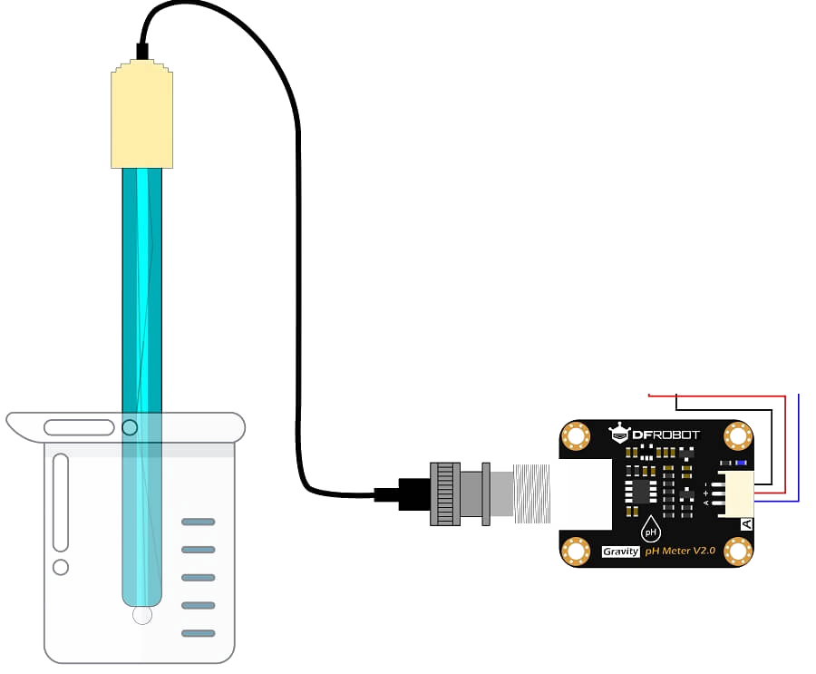
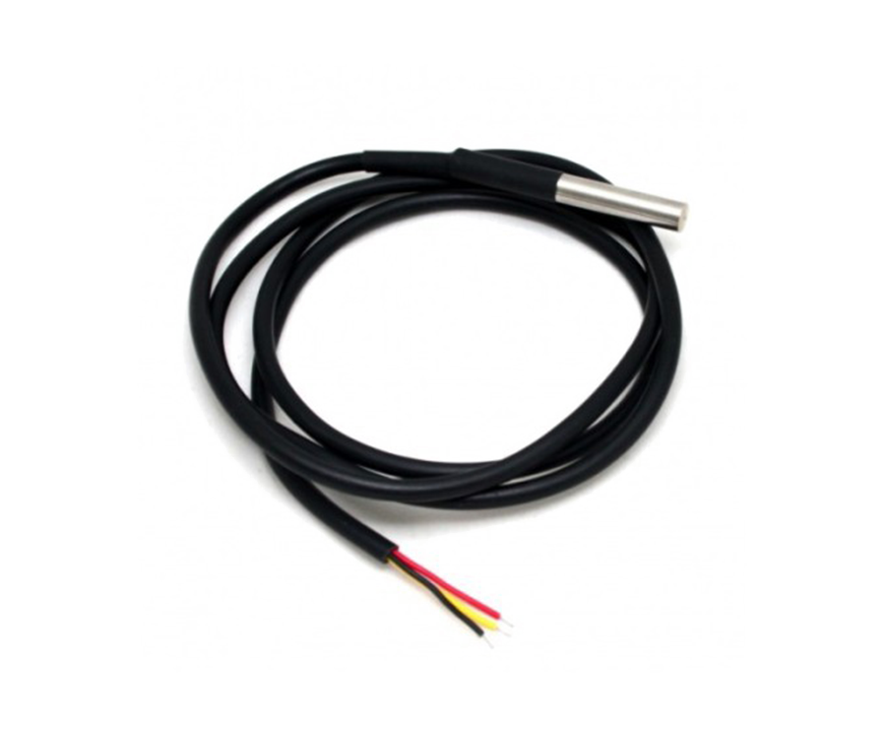
HARDWARE COMPONENTS
Ph meter sen-0161
pH signal conversion board + pH probe
Supply Voltage : 3.3V~5.5V
Accuracy : ±0.1 at 25℃
Temperature Range : 5~60 ℃
Response Time: < 1min
Probe Life : 1 year
DS18B20 Waterproof
Communicate using 1 wire method
Operating Voltage: 3V to 5V
Temperature range : -55~125 ℃
Programmable
0.5 ℃ accuracy
Notes:
Alarm function with non-volatile user programmable Upper and lower trigger point

Slide 7
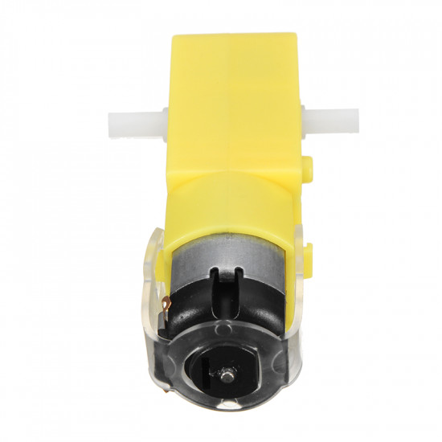
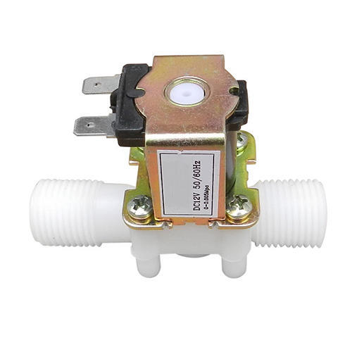
HARDWARE COMPONENTS
DC Geared motor
Operating Voltage : 3-6V
Change speed using PWM on ESP32
G1/2 plastic Solenoid valve
Normally Closed
Thread : G1/2”
Rated Voltage : 12V
Current 300mA
Applicable fluid Temperature : 0~55 ℃
Applicable Water pressure : 0.02-0.8MPa
Notes:
Alarm function with non-volatile user programmable Upper and lower trigger point

Slide 8
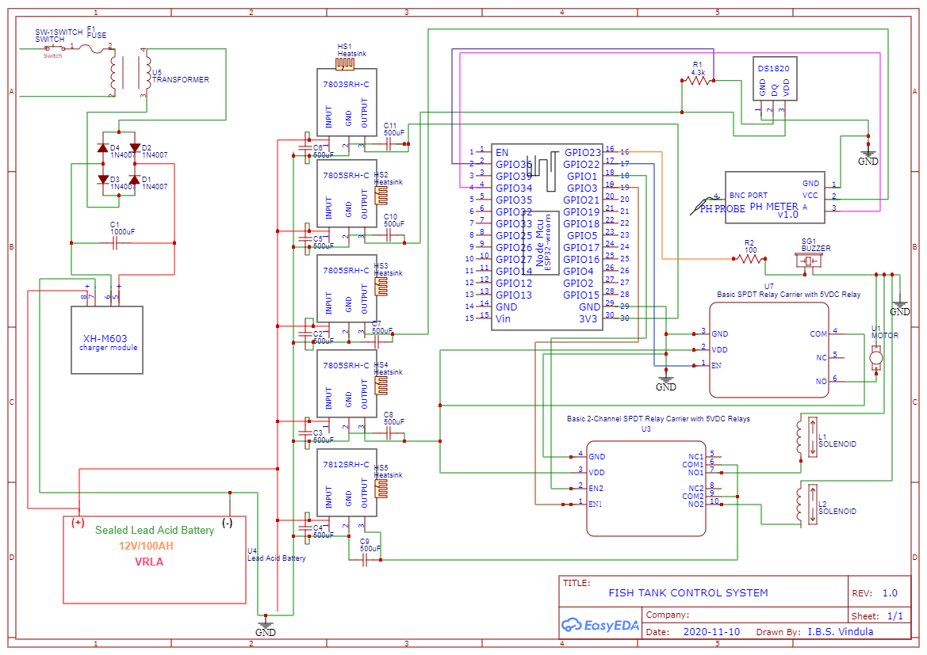
FISH TANK CONTROLLER
Notes:
Alarm function with non-volatile user programmable Upper and lower trigger point

Slide 9

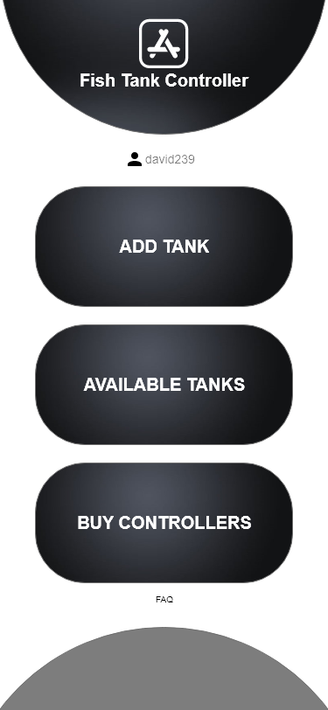

User interface
Notes:
Alarm function with non-volatile user programmable Upper and lower trigger point

Slide 10


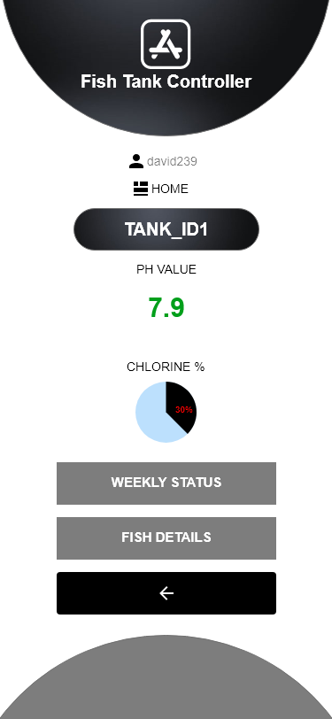


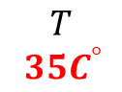
User interface
$$T$$
$${ 35C}^{° }$$
TEMPERATURE
Notes:
Alarm function with non-volatile user programmable Upper and lower trigger point

Slide 11
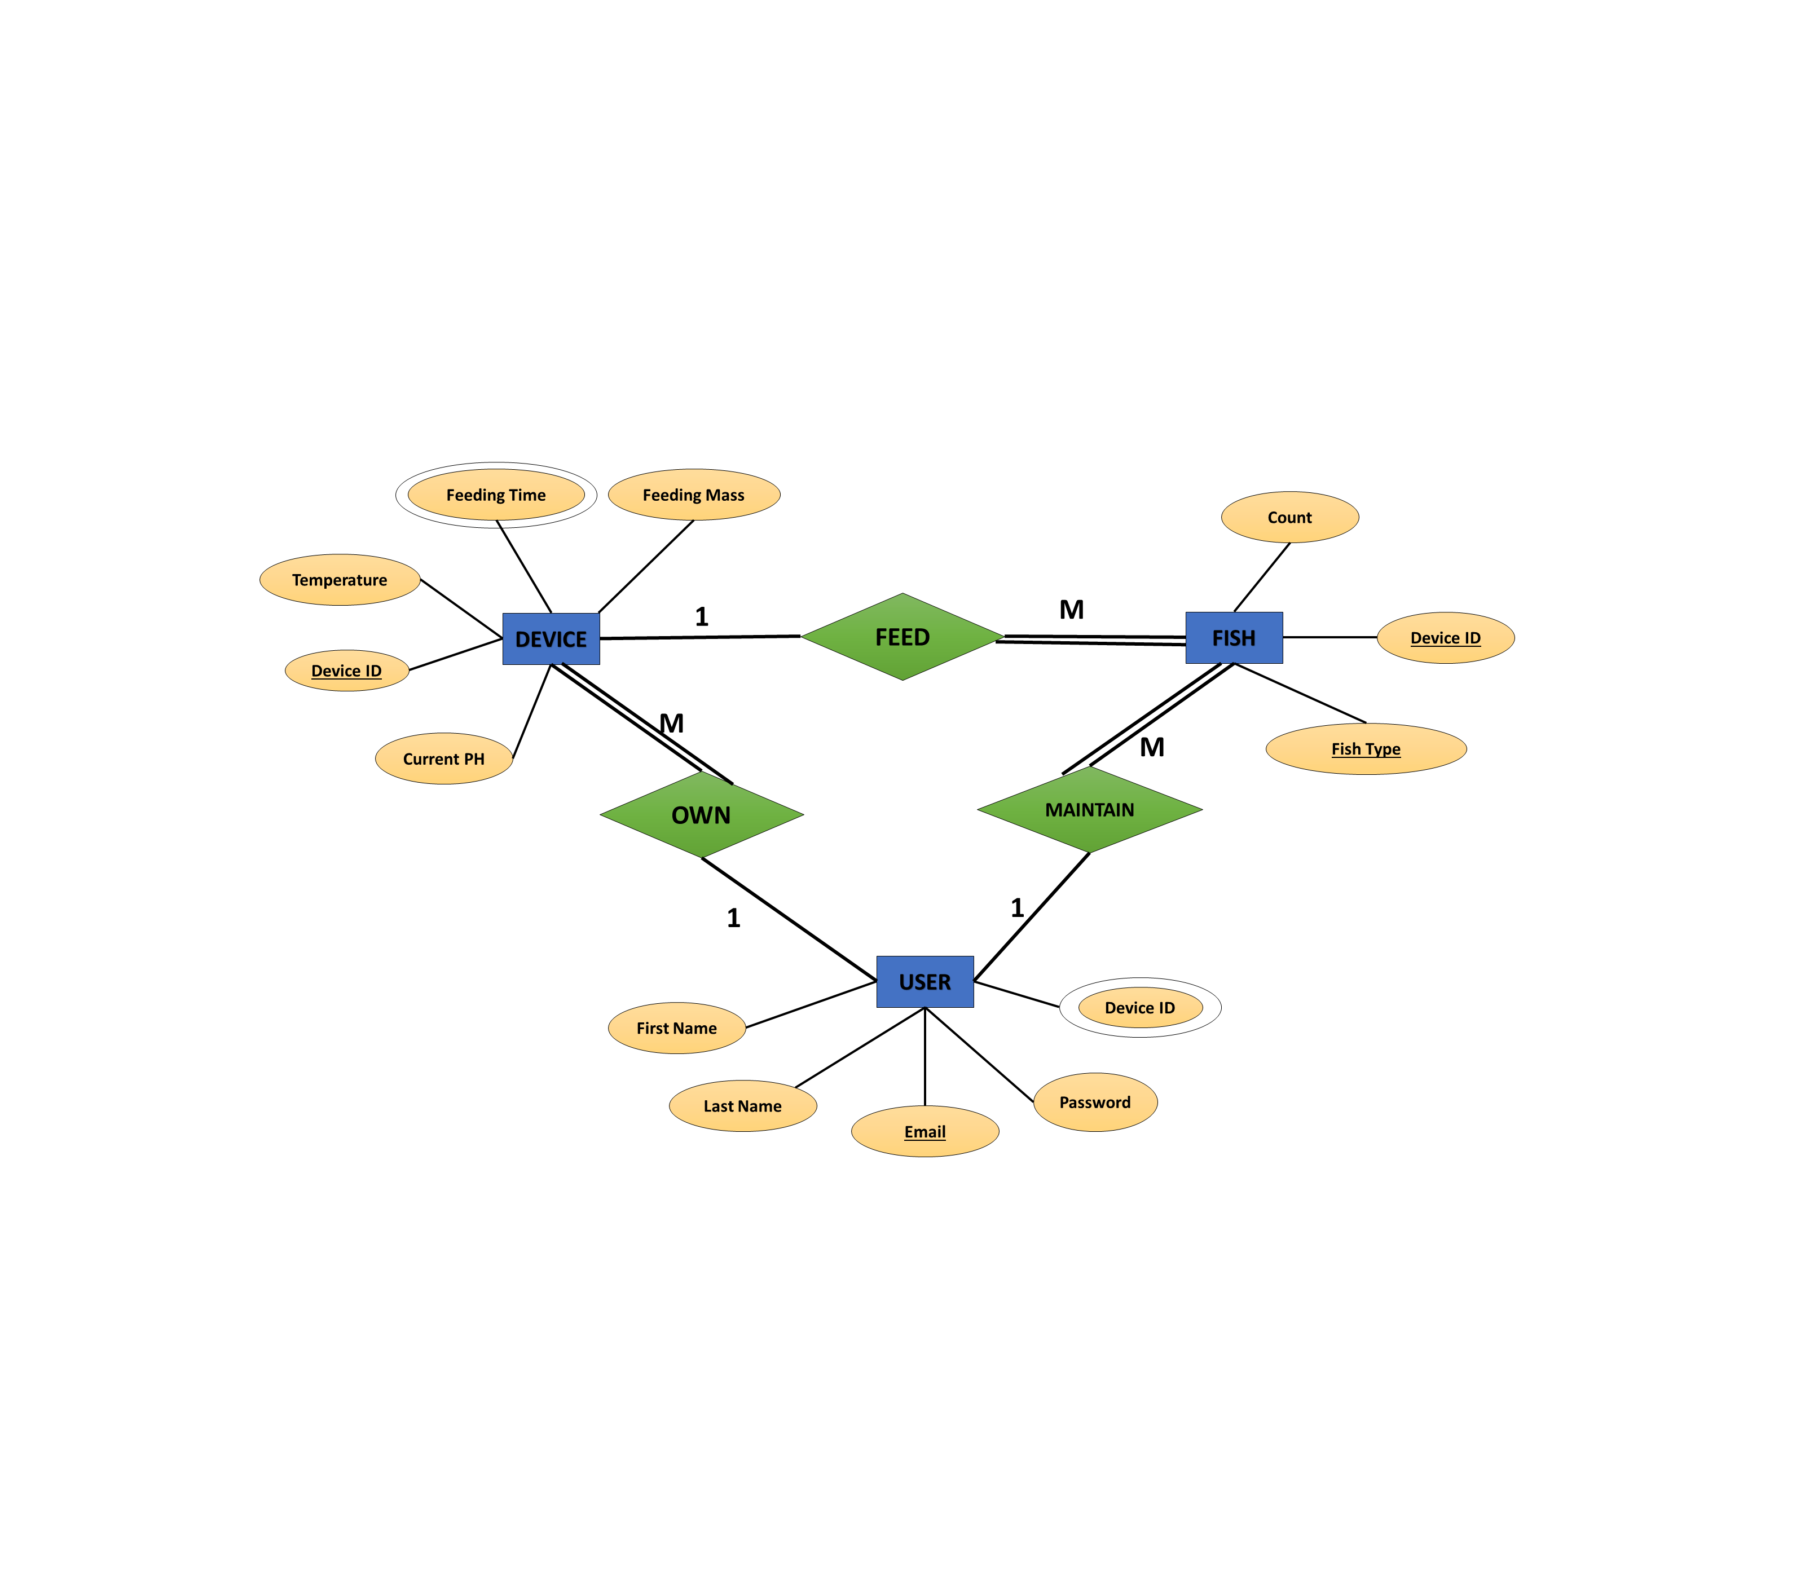
ER diagram
Notes:
Alarm function with non-volatile user programmable Upper and lower trigger point

Slide 12
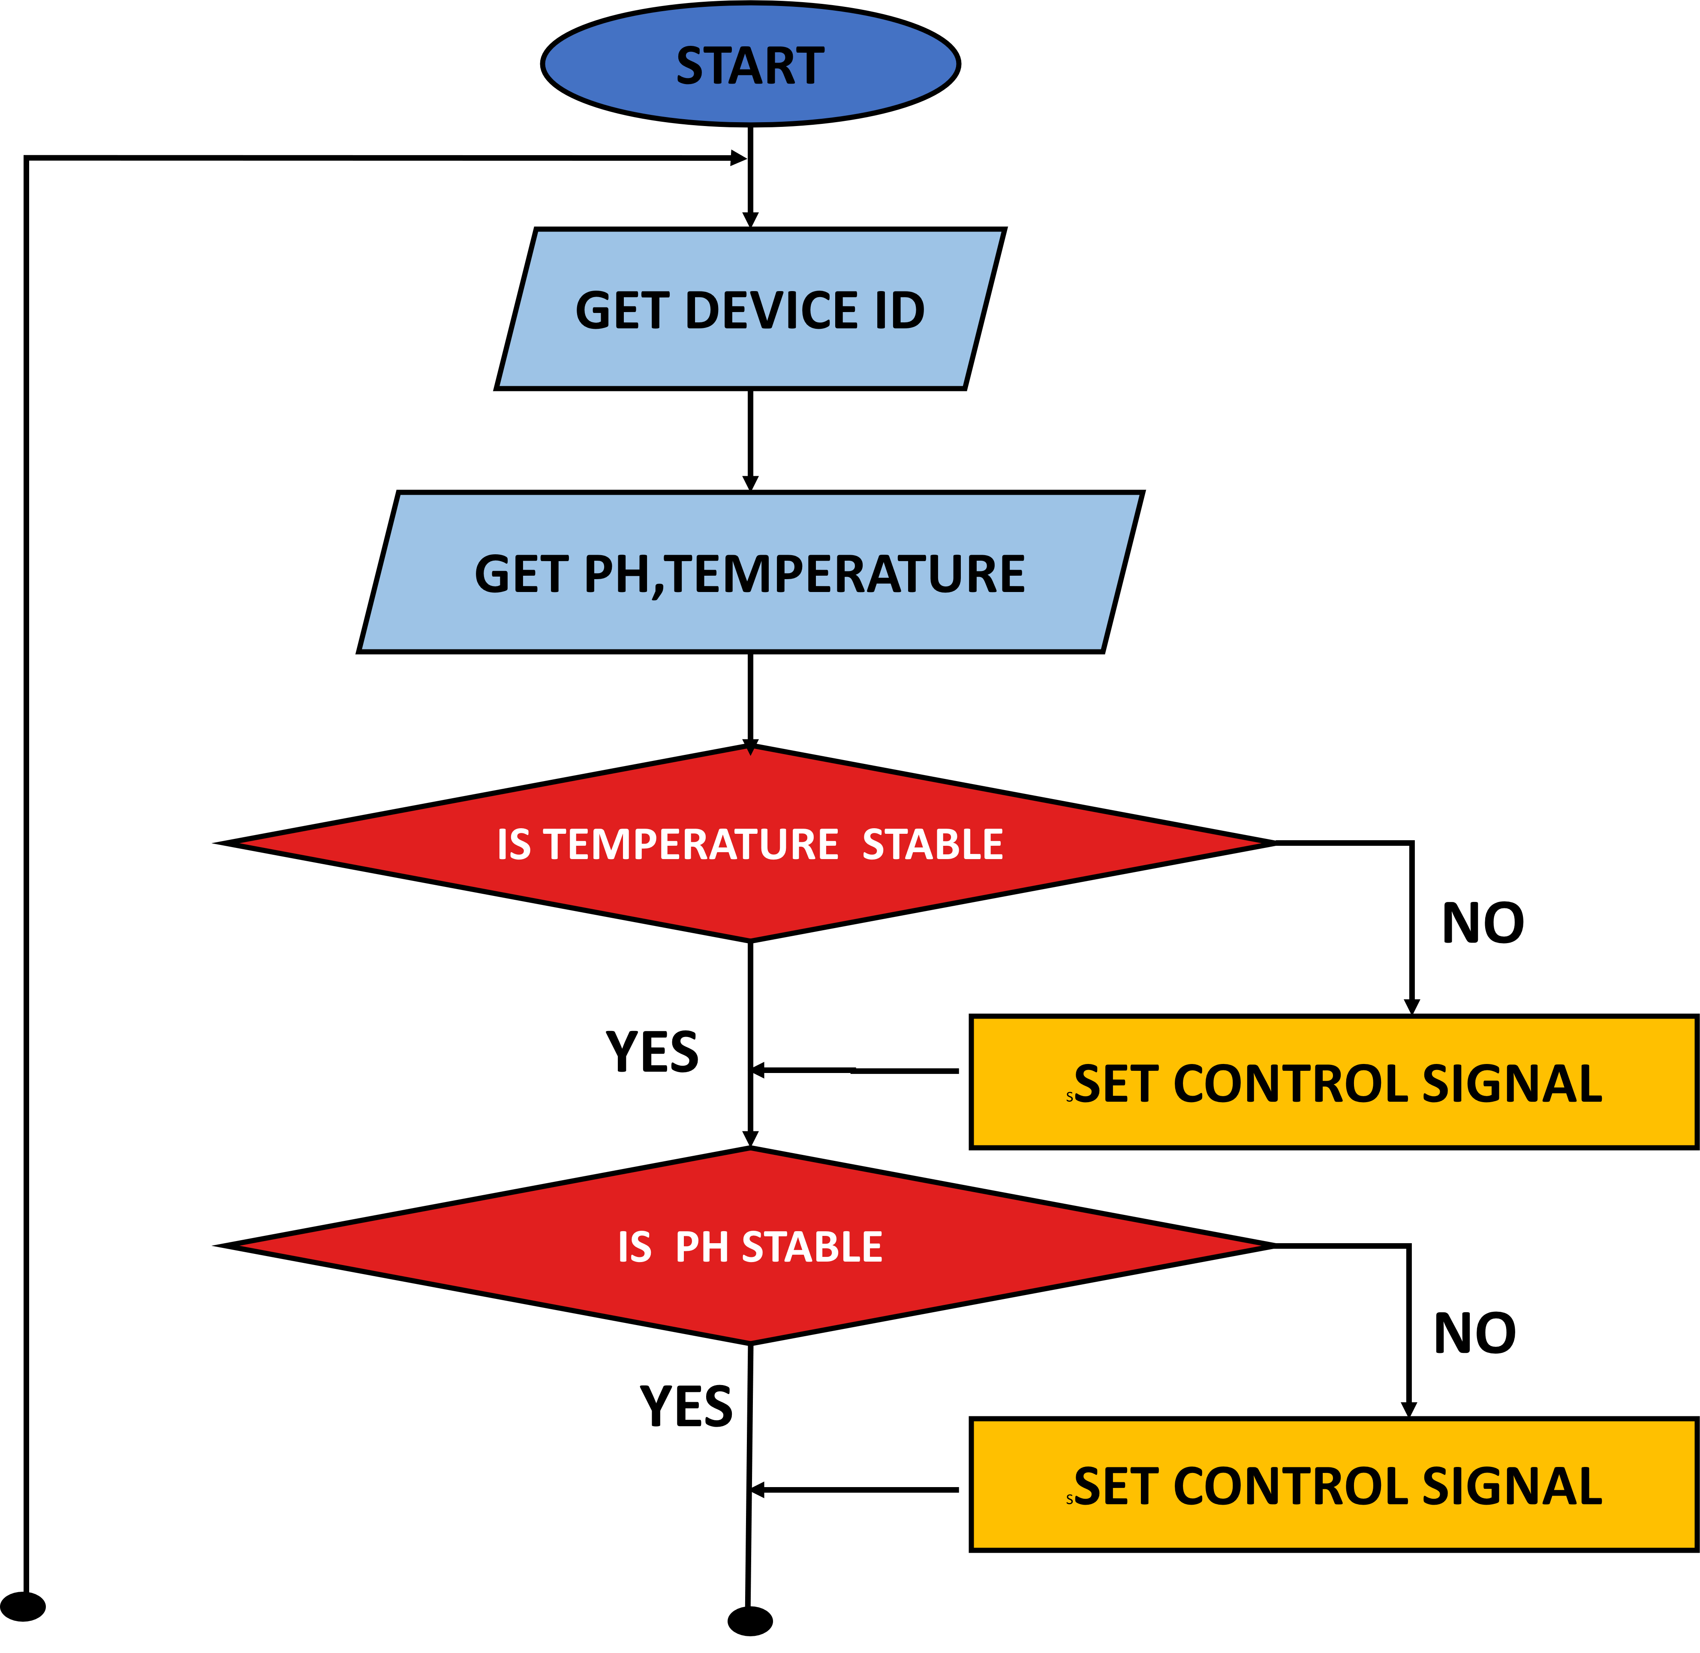
Flow contd.
Notes:
Alarm function with non-volatile user programmable Upper and lower trigger point

Slide 13
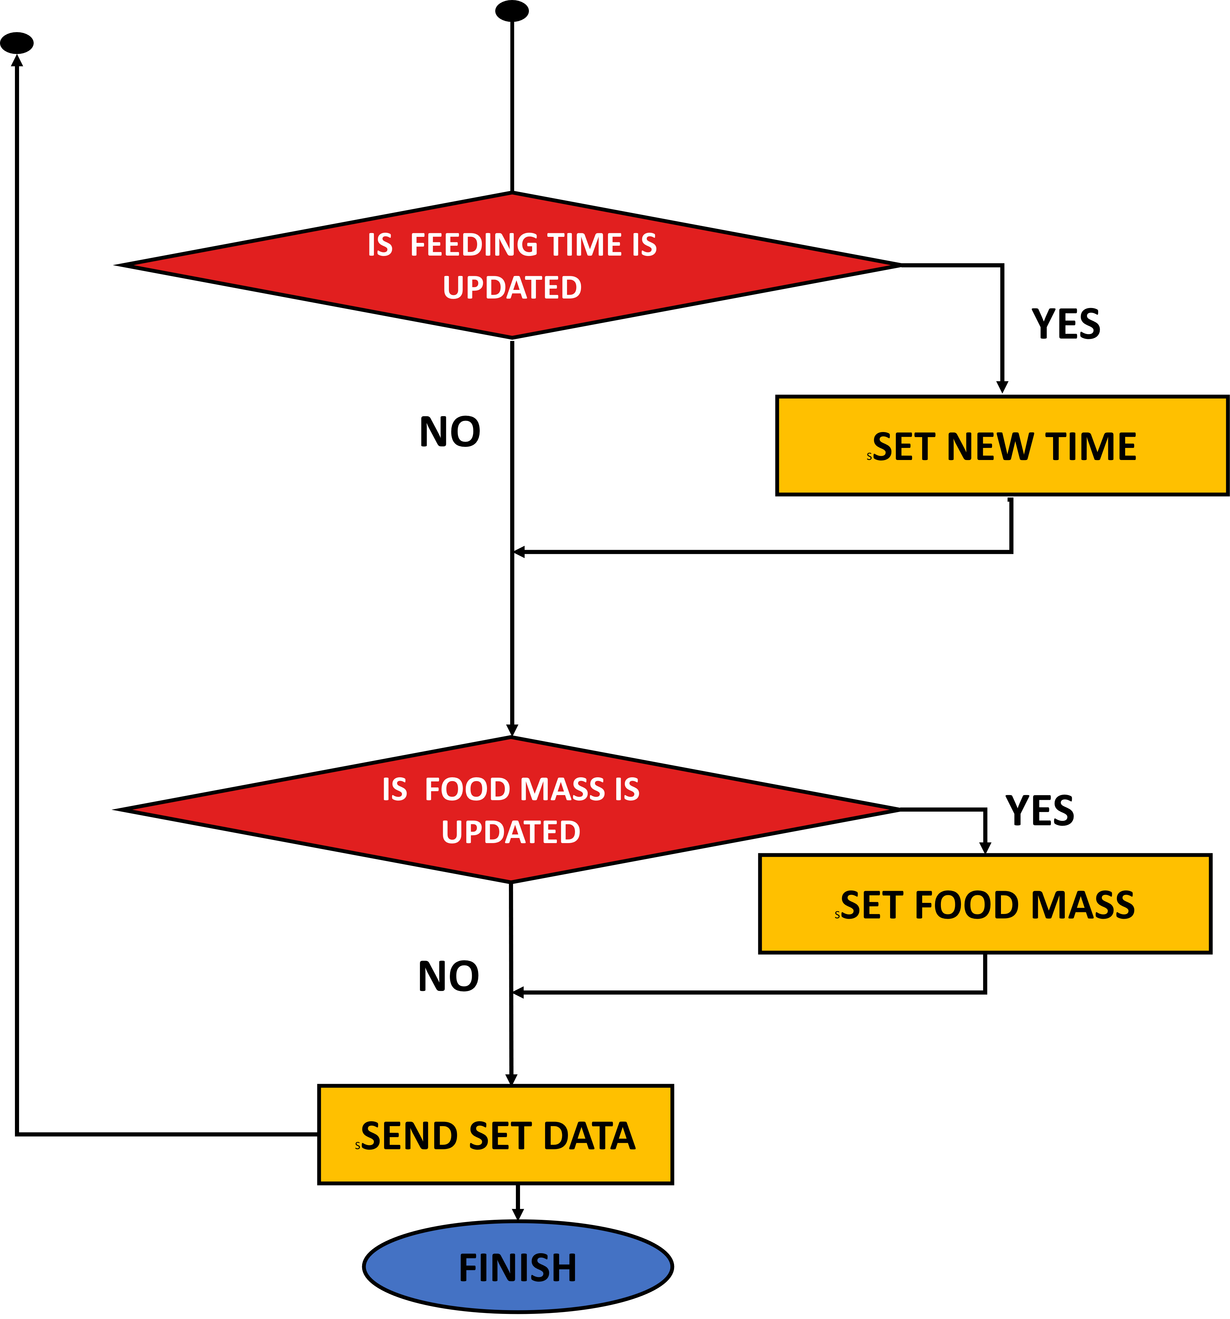
Notes:
Alarm function with non-volatile user programmable Upper and lower trigger point

Slide 14

AWS SERVER
EC2 instances with scalable computing capacity
Ubuntu on AWS
Have elastic load balancing
Good Security through identity access management
Notes:
Alarm function with non-volatile user programmable Upper and lower trigger point

Slide 15


Mongodb
High Performance
Flexible schema
Document Model
Safe from SQL injection
influxdb
Time-slot aggregated data
Handle high write and query loads
Notes:
Alarm function with non-volatile user programmable Upper and lower trigger point

Slide 16

FAST API
Easy to design middleware
Can run background processes
Asynchronous API functions
Support Web sockets
Swagge UI to debug easily
Notes:
Alarm function with non-volatile user programmable Upper and lower trigger point

Slide 17

Uvicorn server
Thread concurrency
Good reload and debug functioning
Good performance on massive loads
Compatible with HTTP 1.1, HTTP 2 and web sockets
Notes:
Alarm function with non-volatile user programmable Upper and lower trigger point

Slide 18

flutter
Can use across different platforms
High Stability
Fully compiled to native app
Compiled to its own widgets
Fast rendering
Notes:
Alarm function with non-volatile user programmable Upper and lower trigger point

Slide 19

SECURITY
2 Factor authentication
JWT Tokens for authorization
Rate limiting method for preventing DOS attack (slow API)
Error Handling in every data manipulation to avoid server failures
Encrypted data transfer
Notes:
Alarm function with non-volatile user programmable Upper and lower trigger point. 30min

Slide 20

FAILURE HANDLING
Show warnings in Over Usage
Store within the device, when there is no connection to server
Battery powered when there is no electricity
Sound buzzer if something wrong
Notes:
Alarm function with non-volatile user programmable Upper and lower trigger point. 30min

Slide 21
BUDGET
Item | Quantity | Price | Item | Quantity | Price
5A Fuse | 1 | 20 | pH sensor kit | 1 | 3800
Switch (AC) | 1 | 40 | 100 resistor | 2 | 2
230V-12V transformer | 1 | 1500 | SGI buzzer | 1 | 50
IN4007 diode | 4 | 100 | 5V relay 1ch | 1 | 90
25V 1000MF Capacitor | 1 | 30 | 5V relay 2ch | 1 | 180
12V Lead acid battery | 1 | 1800 | Geared motor | 1 | 150
7803SRH-C | 1 | 20 | 12V Solenoid valve | 2 | 1380
7805SRH-C | 4 | 60 | Heatsink | - | 100
7812SRH-C | 2 | 40 | Wires and other | - | 200
ESP32-WROOM KIT | 1 | 1500 | 25V 500MF Capacitor | 10 | 150
DS18B20 Sensor | 1 | 200 | XH-M603 Module | 1 | 700
4.3k resistor | 2 | 2 | TOTAL COST | - | 12114LKR
Notes:
Alarm function with non-volatile user programmable Upper and lower trigger point. 30min

Slide 22
Q & A
Notes:
Alarm function with non-volatile user programmable Upper and lower trigger point. 30min

Slide 23
Thank you!
Notes:
Alarm function with non-volatile user programmable Upper and lower trigger point. 30min

